Slide 1
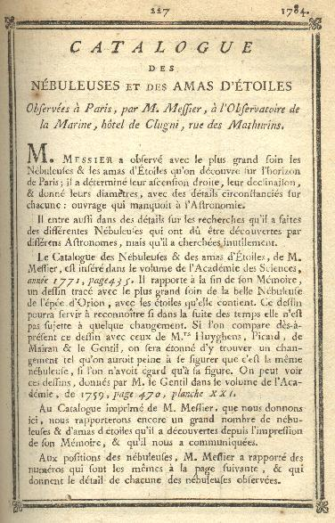
Charles Messier
Click on the down arrow on your keyboard to go to the next page, up arrow takes you back

Slide 2
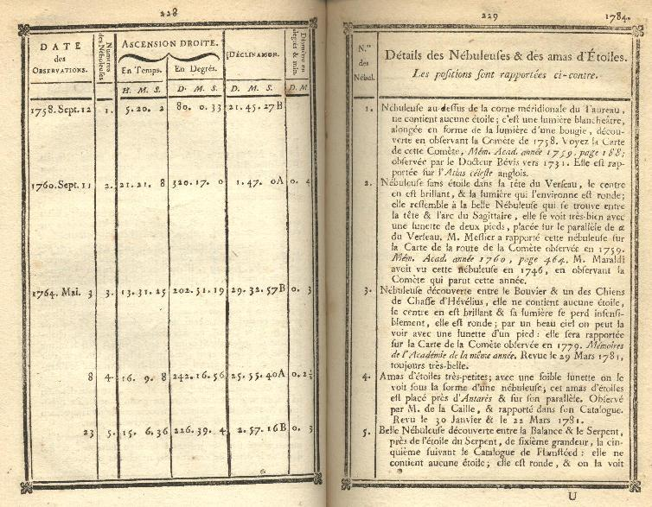
Charles Messier

Slide 3
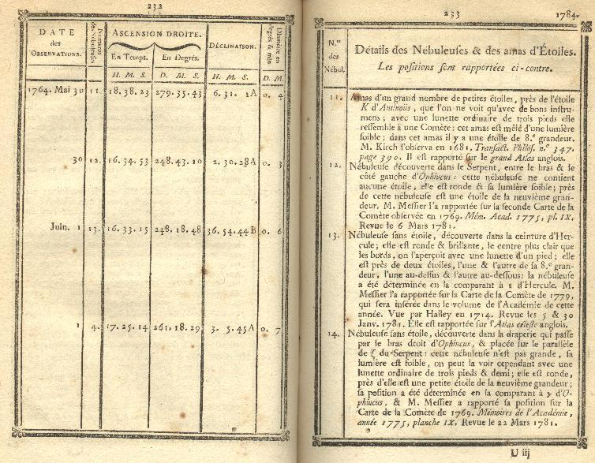
Charles Messier

Slide 4
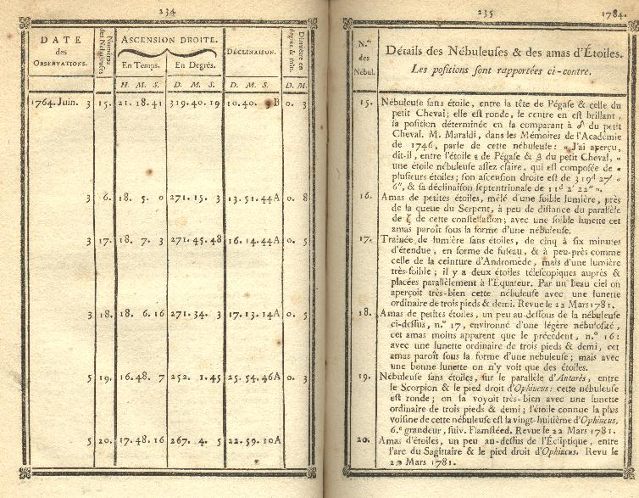
Charles Messier

Slide 5
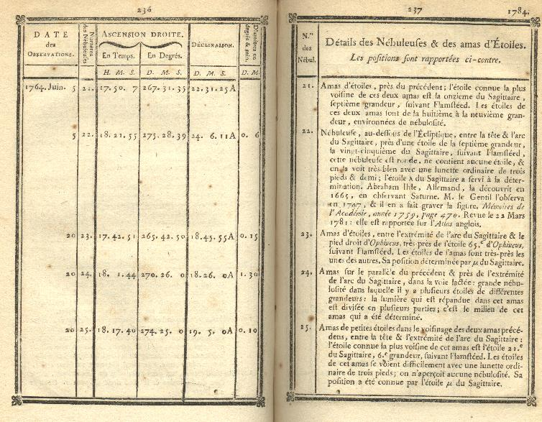
Charles Messier

Slide 6
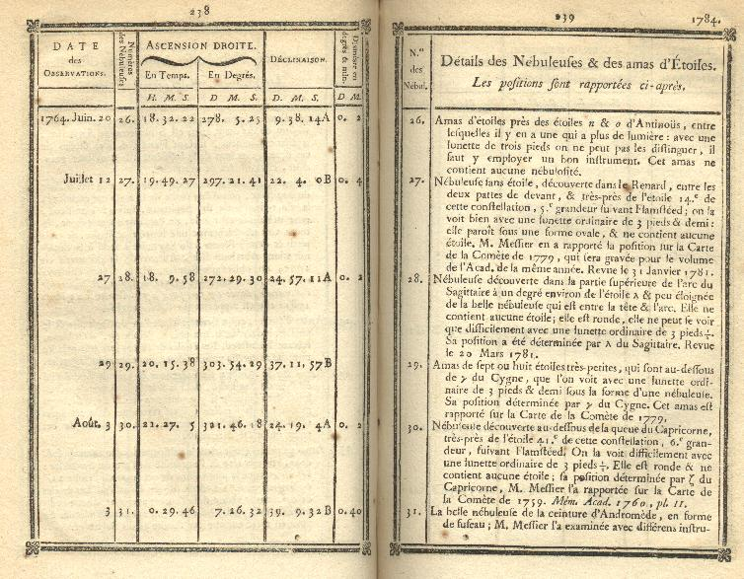
Charles Messier

Slide 7
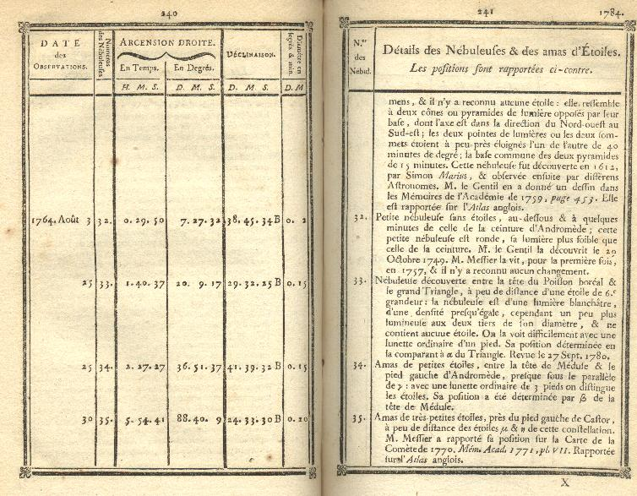
Charles Messier

Slide 8
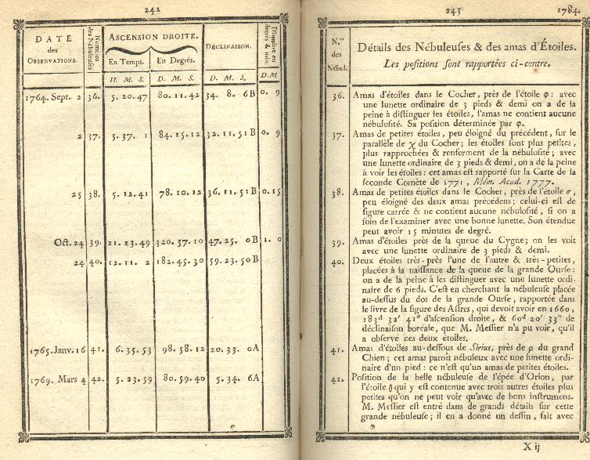
Charles Messier

Slide 9
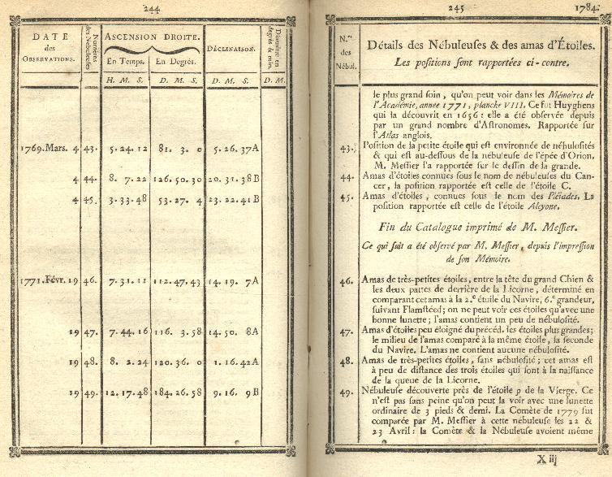
Charles Messier

Slide 10
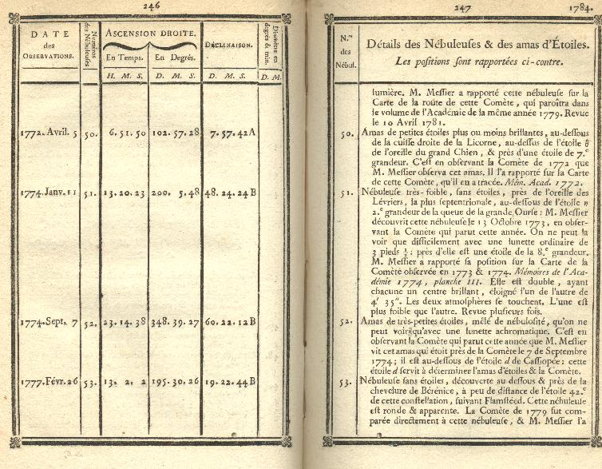
Charles Messier

Slide 11
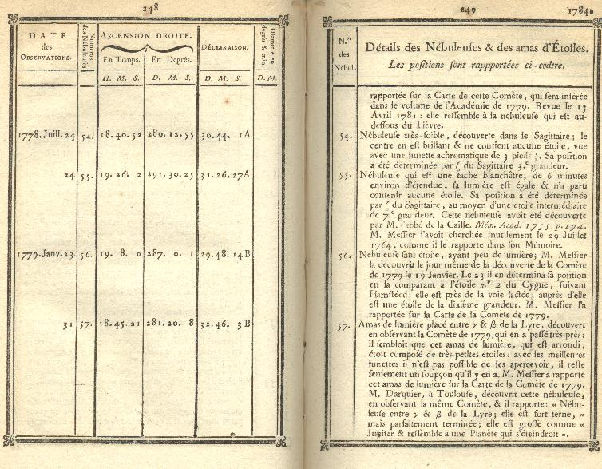
Charles Messier

Slide 12
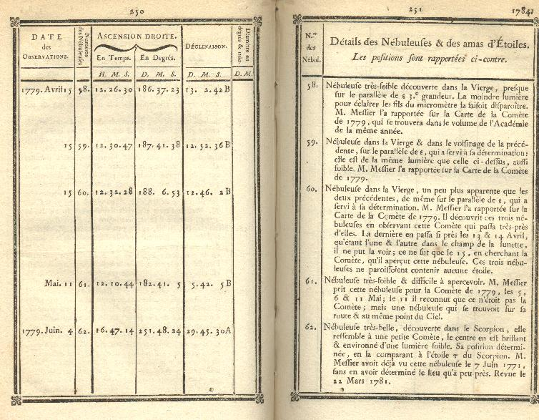
Charles Messier

Slide 13
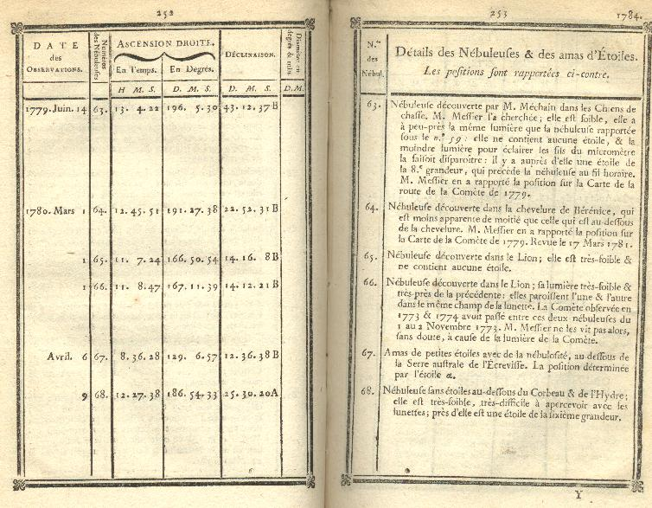
Charles Messier

Slide 14
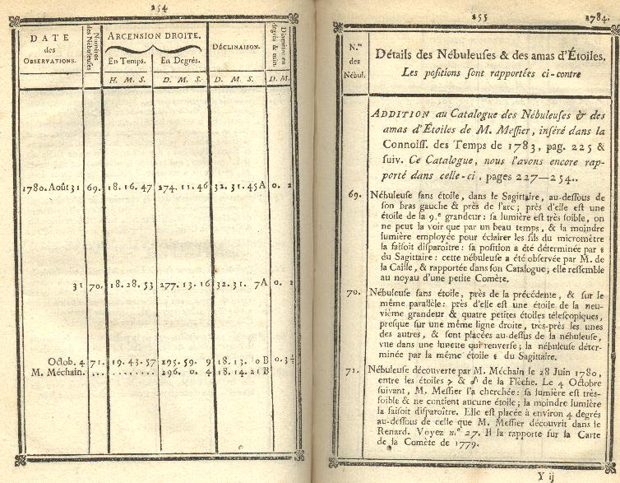
Charles Messier

Slide 15
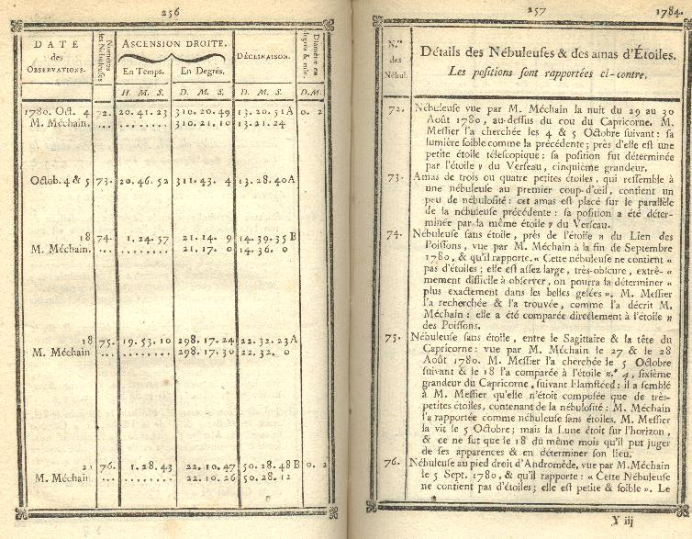
Charles Messier

Slide 16
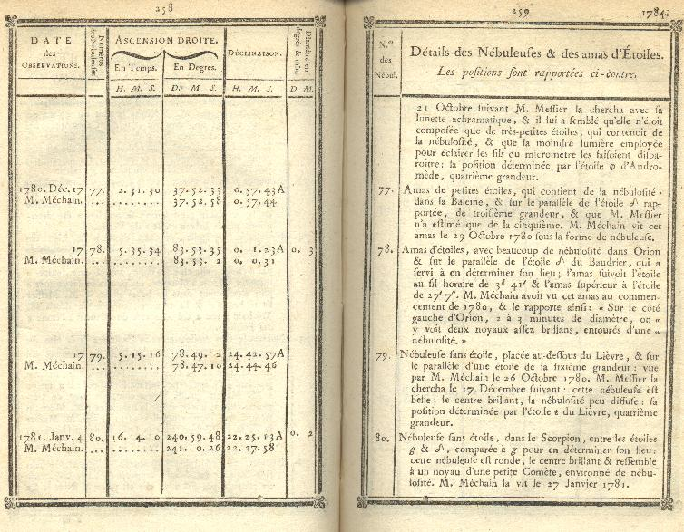
Charles Messier

Slide 17
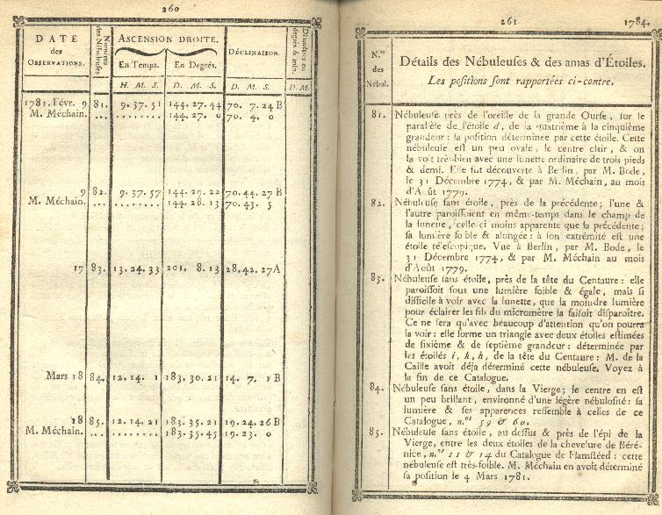
Charles Messier

Slide 18
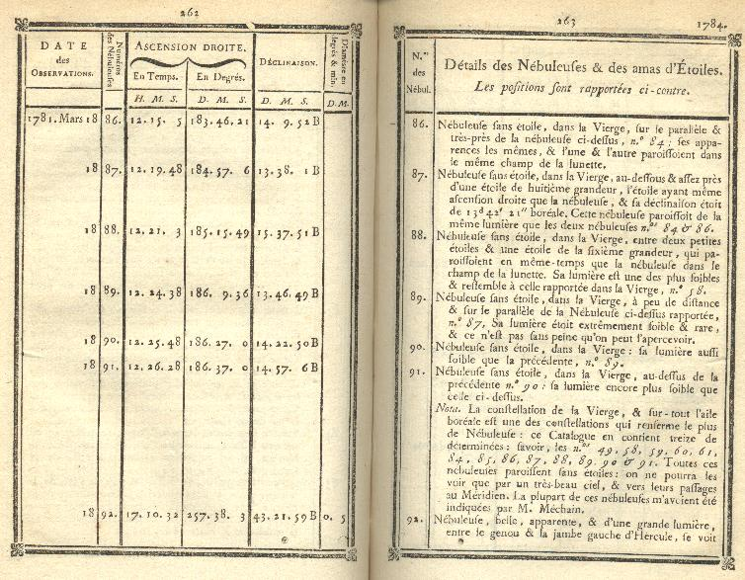
Charles Messier

Slide 19
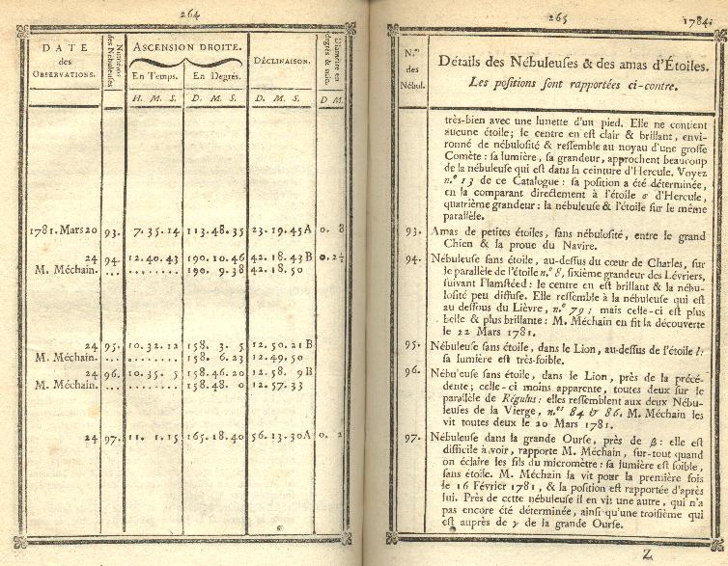
Charles Messier

Slide 20
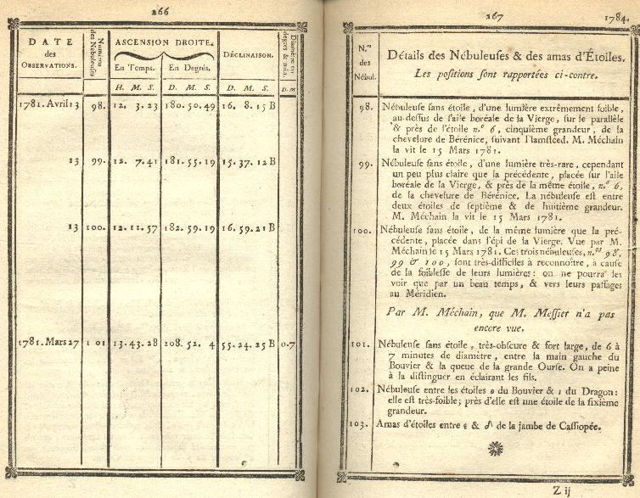
Charles Messier

Slide 21
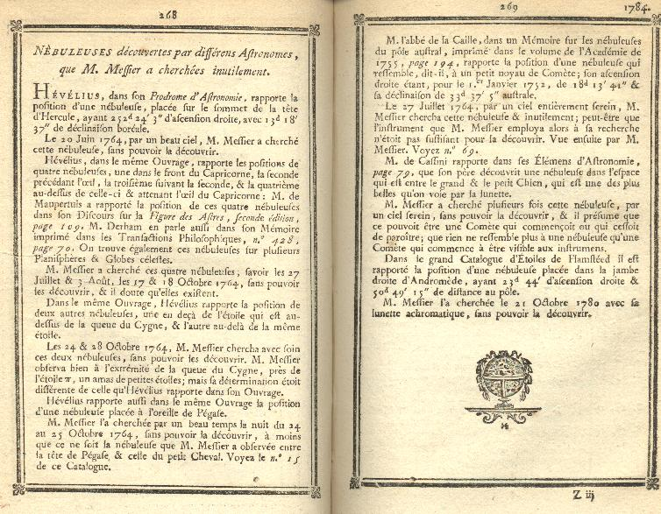
Charles Messier

Slide 22
Charles Messier

