Slide 1
Orion Constellation
Images by
Chanan Greenberg

Slide 3
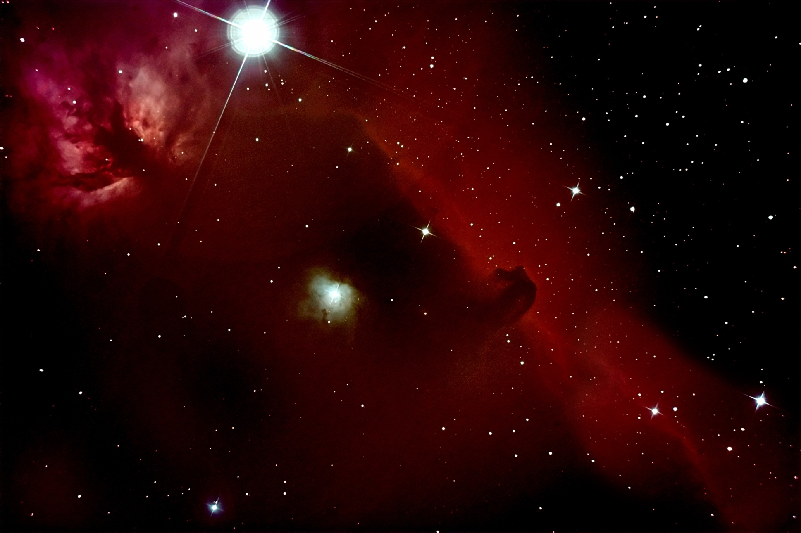
The Horsehead Nebula & Flame Nebula
Chanan Greenberg
October 22, 2008
35 minute exposure
Orion StarShoot Deep Space Pro

Slide 4
The Horsehead Nebula & Flame Nebula
The Horsehead Nebula (also known as Barnard 33 in bright nebula IC 434) is a dark nebula in the Orion constellation. The nebula is located just below Alnitak, the star furthest left on Orion's Belt, and is part of the much larger Orion Molecular Cloud Complex. It is approximately 1500 light years from Earth. It is one of the most identifiable nebulae because of the shape of its swirling cloud of dark dust and gases, which is similar to that of a horse's head. The shape was first noticed in 1888 by Williamina Fleming on photographic plate B2312 taken at the Harvard College Observatory.
The red glow originates from hydrogen gas predominantly behind the nebula, ionized by the nearby bright star Sigma Orionis. The darkness of the Horsehead is caused mostly by thick dust, although the lower part of the Horsehead's neck casts a shadow to the left. Streams of gas leaving the nebula are funneled by a strong magnetic field. Bright spots in the Horsehead Nebula's base are young stars just in the process of forming.

Slide 5
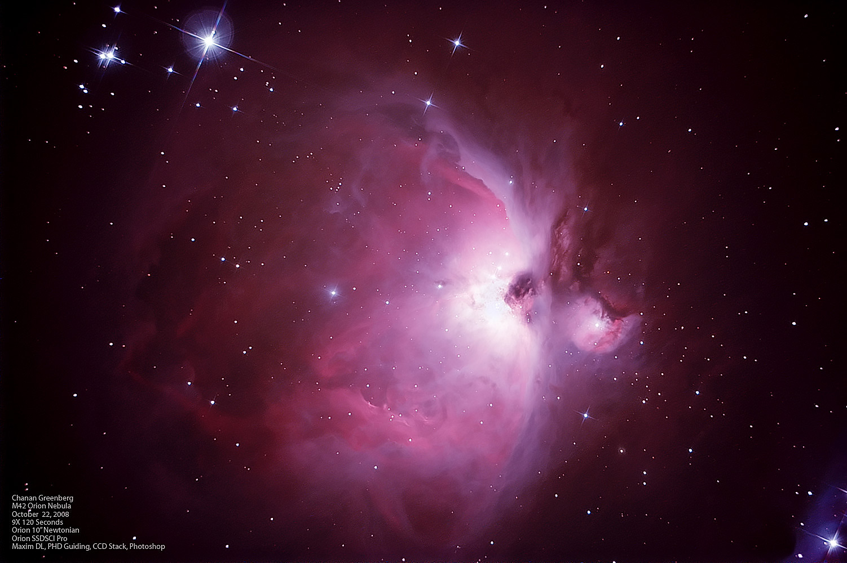
The Orion Nebula (M42)
Chanan Greenberg
October 22, 2008
18 minute exposure
Orion StarShoot Deep Space Pro

Slide 6
The Orion Nebula
The Orion Nebula (also known as Messier 42, M42, or NGC 1976) is a diffuse nebula situated south of Orion's Belt. It is one of the brightest nebulae, and is visible to the naked eye in the night sky. M42 is located at a distance of 1,270 light years and is the closest region of massive star formation to Earth. The M42 nebula is estimated to be 24 light years across.
The Orion Nebula is one of the most scrutinized and photographed objects in the night sky. The nebula has revealed much about the process of how stars and planetary systems are formed from collapsing clouds of gas and dust. Astronomers have directly observed protoplanetary disks, brown dwarfs, intense and turbulent motions of the gas, and the photo-ionizing effects of massive nearby stars in the nebula.

