Slide 1
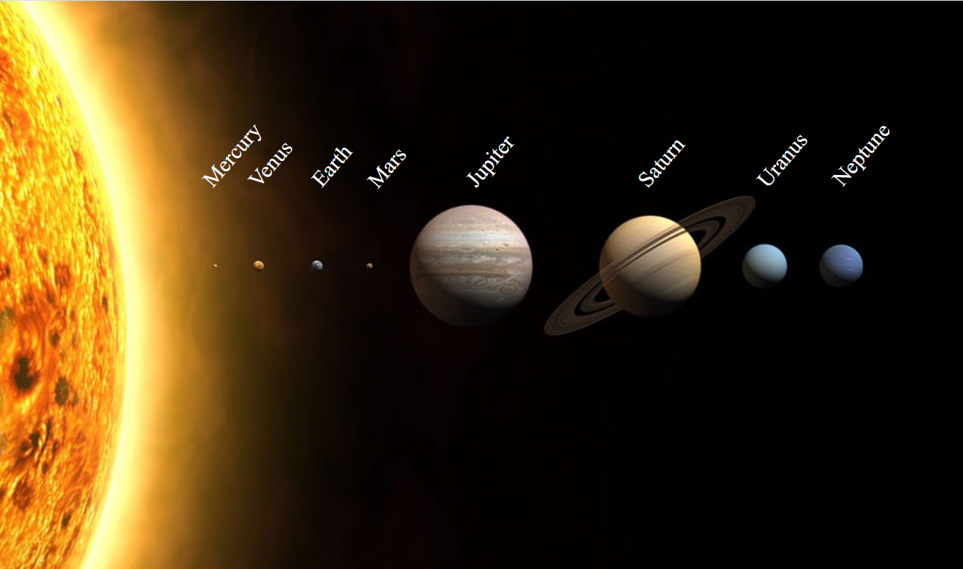
?
What’s Up with Pluto?
+ Make your own Pocket Solar System
Friday June 9, 2020

Slide 2
Content
The Story of Pluto
Why is Pluto not a Planet?
Planets, Asteroids, Comets, Meteors – is this Science?
A different way to think about the Solar System
Make your own Pocket Solar System

Slide 3
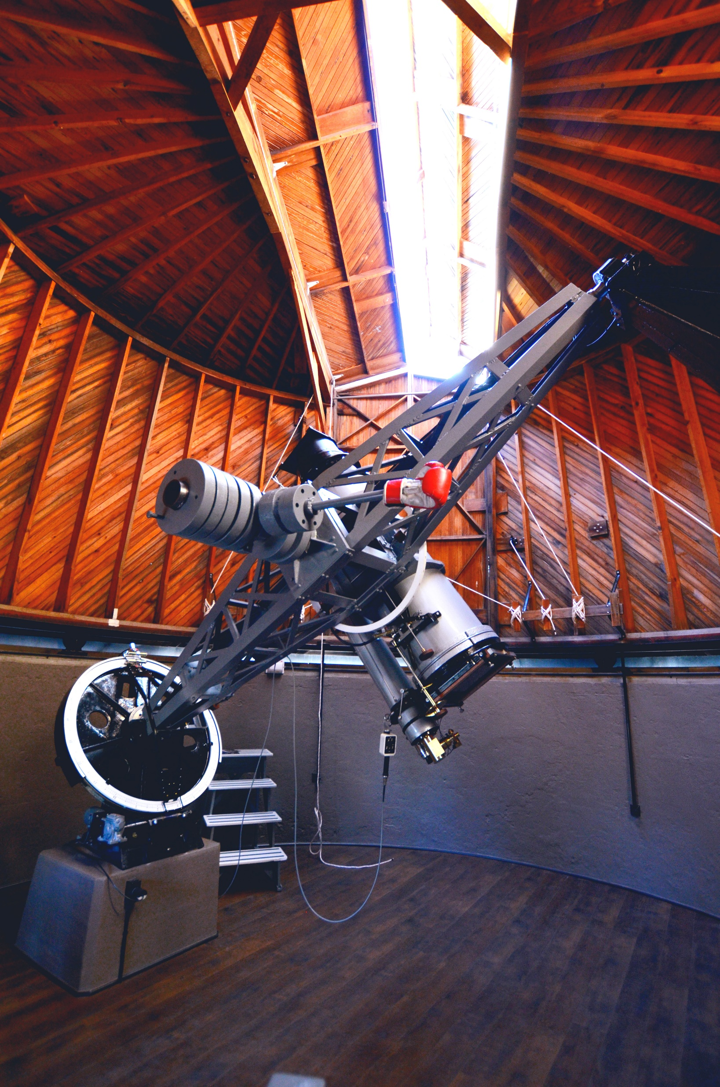
The Story of Pluto
Pluto was discovered on February 18, 1930 by Clyde Tombaugh at the Lowell Observatory in Flagstaff Arizona
It was named by an 11 year old girl from England
It is more than 40 times further away from the sun than Earth

Slide 4
The Story of Pluto
Despite its small size Pluto has 5 moons: Charon which is half the size of Pluto, Nyx, Styx, Kerberos and Hydra all much smaller
Hubble Image on the left
Pluto is about 1,400 miles wide a little smaller than our moon
It takes Pluto 248 years to go once around
the sun

Slide 5
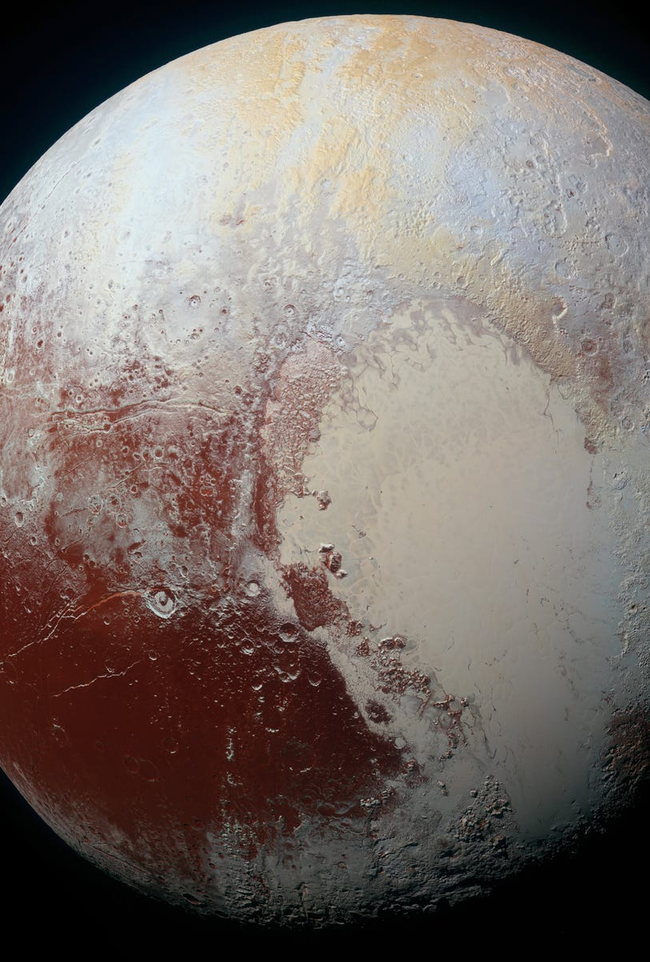
The Story of Pluto
Pluto is VERY cold – 375 degrees (F) below zero. It is mostly ice. But not just water ice, it is frozen nitrogen, methane and carbon monoxide.
It is part of an area called the Kuiper Belt which has many small icy objects. Pluto is one of them.
For 76 years we all called it a Planet…

Slide 6
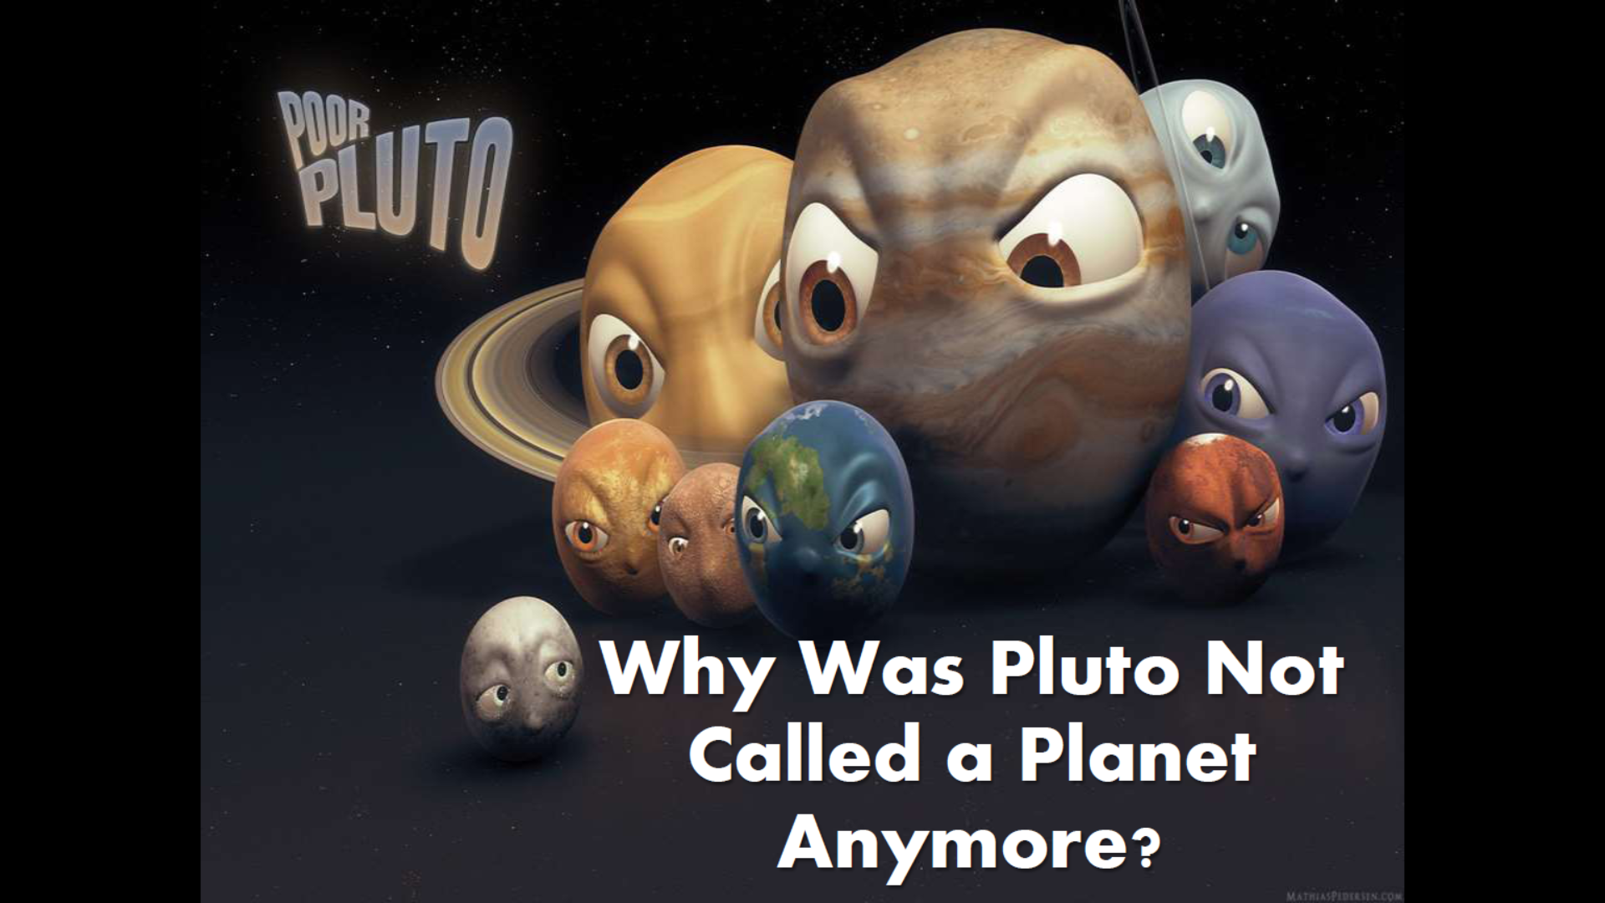
Content
The Story of Pluto
Why is Pluto not a Planet?
Planets, Asteroids, Comets, Meteors – is this Science?
A different way to think about the Solar System
Make your own Pocket Solar System

Slide 7
Why is Pluto not a Planet?
In 2003 astronomers found another object, bigger than Pluto also located in the Kuiper Belt, they named it Eris.
This started a discussion about “what is a planet”?
We have since then found more objects of a similar size – are they all Planets?

Slide 8
Why is Pluto not a Planet?
In 2006 the International Astronomical Union, debated and then voted on the definition of what is a Planet.
The new definition of a planet is:
orbits the sun
has sufficient mass to be round, or nearly round
is not a satellite (moon) of another object
has removed debris and small objects from the area around its orbit
Pluto does not meet the 3rd and 4th requirements and was therefore designated a “Dwarf Planet” along with other objects

Slide 9
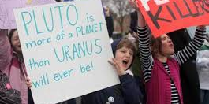
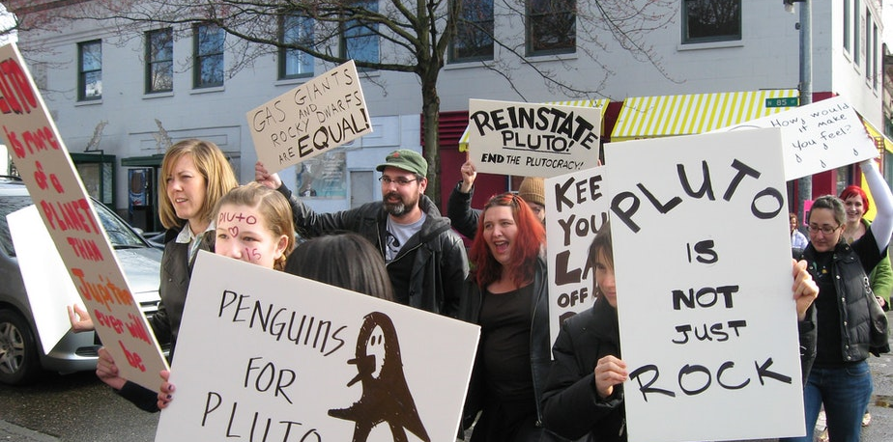
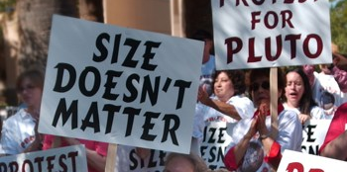
Pluto Protest!!
Harvard science historian Owen Gingerich, who chairs the IAU (International Astronomical Union) planet definition committee, argued that "a planet is a culturally defined word that changes over time," and that Pluto is a planet.

Slide 10
Planets, Asteroids, Meteors, Comets – is this Science?
Term | Origin (Greek) | Meaning
Planet
Planetes
Wanderer
Asteroid
Asteroeides
Star-like
Meteor
Meteoron
Lofty / Moving through air
Comet
Kometes
Long haired
Nothing about: Temperature, Density, Pressure, Chemical composition, you know, things that science deals with

Slide 11
A Different Way to think about our Solar System
Our Solar System consists of:
1 Star – which is a ball of incandescent (glowing) gas
Rocky Objects made of mostly silicon and iron (Mercury, Venus, Earth, Mars, Ceres)
Gas Objects (Jupiter, Saturn, Uranus, Neptune)
Icy Objects (Pluto, Eris and thousands of objects in the Kuiper Belt)
Pluto was a ball of ice before it was discovered by humans,
it remained a ball of ice after we named it a planet, and it
stayed a ball of ice after we called it a dwarf planet.
Whether you call it a “Wanderer” or a “Dwarf Wanderer” does
not change what Pluto is.

Slide 12
Making your Own Pocket Solar System

Slide 13
Pocket Solar System: Step 1
Sun
Write at the top of your strip of paper the word Sun in small letters
Write at the bottom Kuiper Belt (or K.B. for short)
K.B.

Slide 14
Pocket Solar System: Step 2
Sun
Fold your paper in Half and make a crease.
Unfold the paper, and draw a line where the crease is and write down the name of the planet
Uranus
K.B.

Slide 15
Pocket Solar System: Step 3
Sun
Saturn
Fold your paper in Half and then fold it in half again
Make a crease
Open the paper. Now you have creases at the ¼ mark and ¾ mark
At the ¾ mark write down the name of the planet
At the ¼ mark write down the name of the next planet
Uranus
Neptune
K.B.

Slide 16
Pocket Solar System: Step 4
Sun
Jupiter
Saturn
Fold the sun (top of the paper) down to Saturn’s line and make a crease
At the 1/8 mark write down the name of the planet
Uranus
Neptune
K.B.

Slide 17
Pocket Solar System: Step 5
Sun
A.B.
Jupiter
Saturn
Fold the sun (top of the paper) down to Jupiter’s line and make a crease
At the 1/16th mark write down A.B. (stands for Asteroid Belt)
Uranus
Neptune
K.B.

Slide 18
Pocket Solar System: Step 6
Sun
Mars
A.B.
Fold the sun (top of the paper) down to the asteroid belt line and make a crease
At the mark write down the name of the planet
Jupiter

Slide 19
Pocket Solar System: Step 7
Sun
Mercury
Venus
Earth
Mars
A.B.
Fold the sun (top of the paper) down to Mars. Keep it folded. Fold that section in half.
Unfold the paper, you should now have 3 creases
At the mark write down the names of the planets
Jupiter

Slide 20
Pocket Solar System: What have we learned
Most of our Solar System is empty space
The inner part of our solar system is quite crowded
At the scale of what you are holding in your hand, the sun would be the size of a grain of sand and the planets would be too small to see
The nearest star would be about 5 miles away

